Slide 1
Introduction to Clustering

Slide 2
K-means clustering
centroid based partitioning approach to clustering.
Input: the set of objects and number of clusters k
K-means (set of objects, number of clusters k)
Select k objects arbitrarily as initial cluster centroids;
Assign/reassign each object to the cluster to which the object is closest based on its distance from the cluster centroid;
Update the cluster centroids;
Repeat steps (2) & (3) until there is no change.

Slide 3
K-means clustering
Consider a dataset D={22, 9, 12, 15, 10, 27, 35, 18, 36, 11}. Create 3 clusters using k-means clustering
Cluster | Objects | Centroids
1 | 22 | 22
2 | 9 | 9
3 | 12 | 12
Cluster | Objects | Centroids
1 | 22, 27, 35, 18, 36 | 27.6
2 | 9, 10 | 9.5
3 | 12, 15, 11 | 12.6
Cluster | Objects | Centroids
1 | 22, 27, 35, 36 | 30
2 | 9, 10, 11 | 10
3 | 12, 15, 18 | 15

Slide 4
K-means clustering
D={22, 9, 12, 15, 10, 27, 35, 18, 36, 11}
Cluster | Objects | Centroids
1 | 22, 27, 35, 36 | 30
2 | 9, 10, 11 | 10
3 | 12, 15, 18 | 15
Cluster | Objects | Centroids
1 | 27, 35, 36 | 32.6
2 | 9, 12, 10, 11 | 10.5
3 | 22, 15, 18 | 18.3
Cluster | Objects | Centroids
1 | 27, 35, 36 | 32.6
2 | 9, 12, 10, 11 | 10.5
3 | 22, 15, 18 | 18.3

Slide 5
Hierarchical clustering
A tree structure called Dendrogram is used to specify the clustering process & the clusters being created.
The root of the Dendrogram is a single clusters with all the objects in it whereas the leaf nodes consist of single element clusters.
Each level of Dendrogram is associated with a distance threshold which was used to form clusters at that level.
There are two approaches
Top down (Divisive): Starts with a single cluster which is iteratively subdivided into smaller clusters.
Bottom up (Agglomerative): Starts with each object in its own cluster and clusters are iteratively merged to form higher level larger clusters.

Slide 6
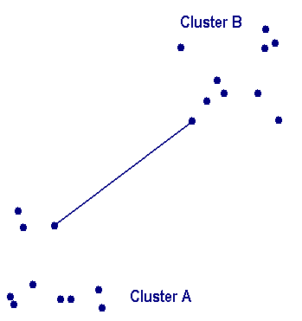
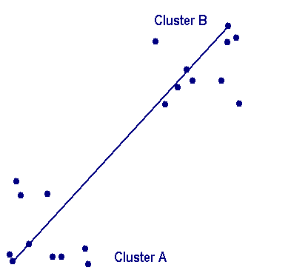
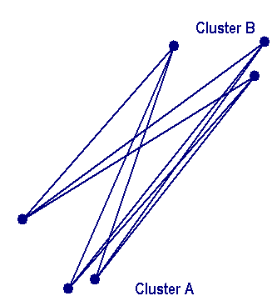
Hierarchical clustering
Bottom up hierarchical clustering
There are three variations, depending up on how the distance between the clusters is calculated.
Single linkage, Complete linkage & Average linkage
Top down hierarchical clustering
In each iteration, one of the existing clusters is selected for split
The split is performed such that the error is minimized

Slide 7
Hierarchical clustering
Food item | Protein | fat
1 | 1.1 | 60
2 | 8.2 | 20
3 | 4.2 | 35
4 | 1.5 | 21
5 | 7.6 | 15
6 | 2 | 55
7 | 3.9 | 39
 | 1 | 2 | 3 | 4 | 5 | 6 | 7
1 | 0
2 | 40.63 | 0
3 | 25.19 | 15.24 | 0
4 | 39 | 6.77 | 14.26 | 0
5 | 45.47 | 5.03 | 20.27 | 8.56 | 0
6 | 5.08 | 35.54 | 20.12 | 34 | 40.39 | 0
7 | 21.19 | 19.48 | 4.01 | 18.16 | 24.29 | 16.11 | 0
 | 1 | 2 | 3,7 | 4 | 5 | 6
1 | 0
2 | 40.63 | 0
3,7 | 21.19 | 15.24 | 0
4 | 39 | 6.77 | 14.26 | 0
5 | 45.47 | 5.03 | 20.27 | 8.56 | 0
6 | 5.08 | 35.54 | 16.11 | 34 | 40.39 | 0
4.01
1 2 3 4 5 6 7 0

Slide 8
Hierarchical clustering
 | 1 | 2,5 | 3,7 | 4 | 6
1 | 0
2,5 | 40.63 | 0
3,7 | 21.19 | 15.24 | 0
4 | 39 | 6.77 | 14.26 | 0
6 | 5.08 | 35.54 | 16.11 | 34 | 0
5.03
4.01
1 2 3 4 5 6 7 0
 | 1,6 | 2,5 | 3,7 | 4
1,6 | 0
2,5 | 35.54 | 0
3,7 | 16.11 | 15.24 | 0
4 | 34 | 6.77 | 14.26 | 0
5.08
5.03
4.01
1 2 3 4 5 6 7 0

Slide 9
Hierarchical clustering
6.77
 | 1,6 | 2,5,4 | 3,7
1,6 | 0
2,5,4 | 34 | 0
3,7 | 16.11 | 14.26 | 0
5.08
5.03
4.01
1 2 3 4 5 6 7 0
16.11
14.26
14.26
6.77
6.77
5.08
5.08
5.03
 | 1,6 | 2,5,4,3,7
1,6 | 0
2,5,4,3,7 | 16.11 | 0
5.03
4.01
4.01
1 2 3 4 5 6 7 0
1 2 3 4 5 6 7 0

Slide 10
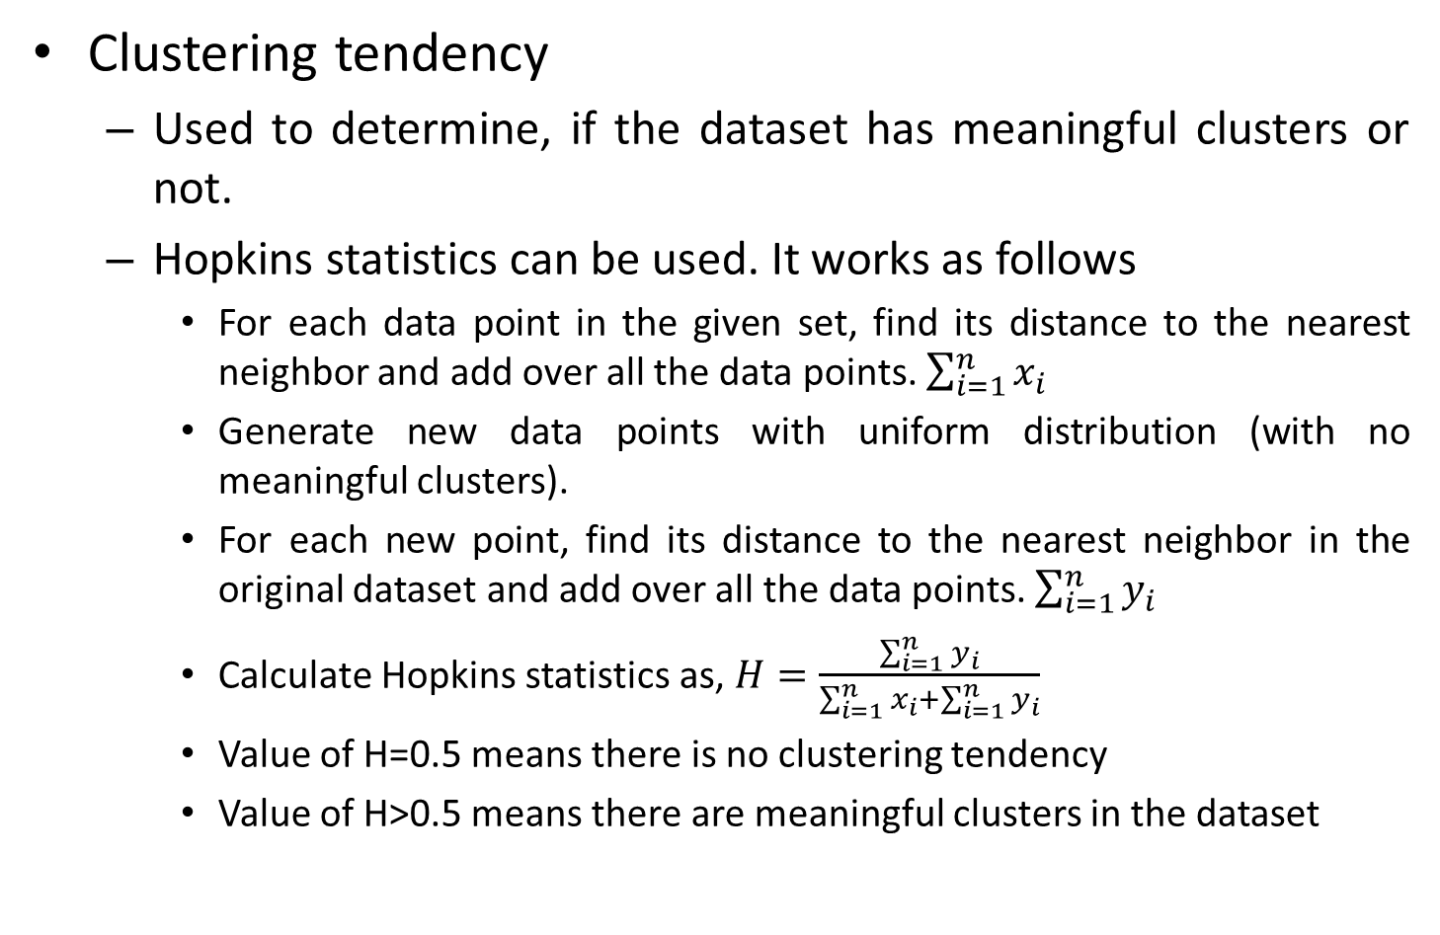
Evaluating clusters
Clustering tendency
Used to determine, if the dataset has meaningful clusters or not.
Hopkins statistics can be used. It works as follows
For each data point in the given set, find its distance to the nearest neighbor and add over all the data points. $\sum_{i=1}^{n}{x_{i}}$
Generate new data points with uniform distribution (with no meaningful clusters).
For each new point, find its distance to the nearest neighbor in the original dataset and add over all the data points. $\sum_{i=1}^{n}{y_{i}}$
Calculate Hopkins statistics as, $H=\frac{\sum_{i=1}^{n}{y_{i}}}{\sum_{i=1}^{n}{x_{i}+\sum_{i=1}^{n}{y_{i}}}}$
Value of H=0.5 means there is no clustering tendency
Value of H>0.5 means there are meaningful clusters in the dataset

Slide 11
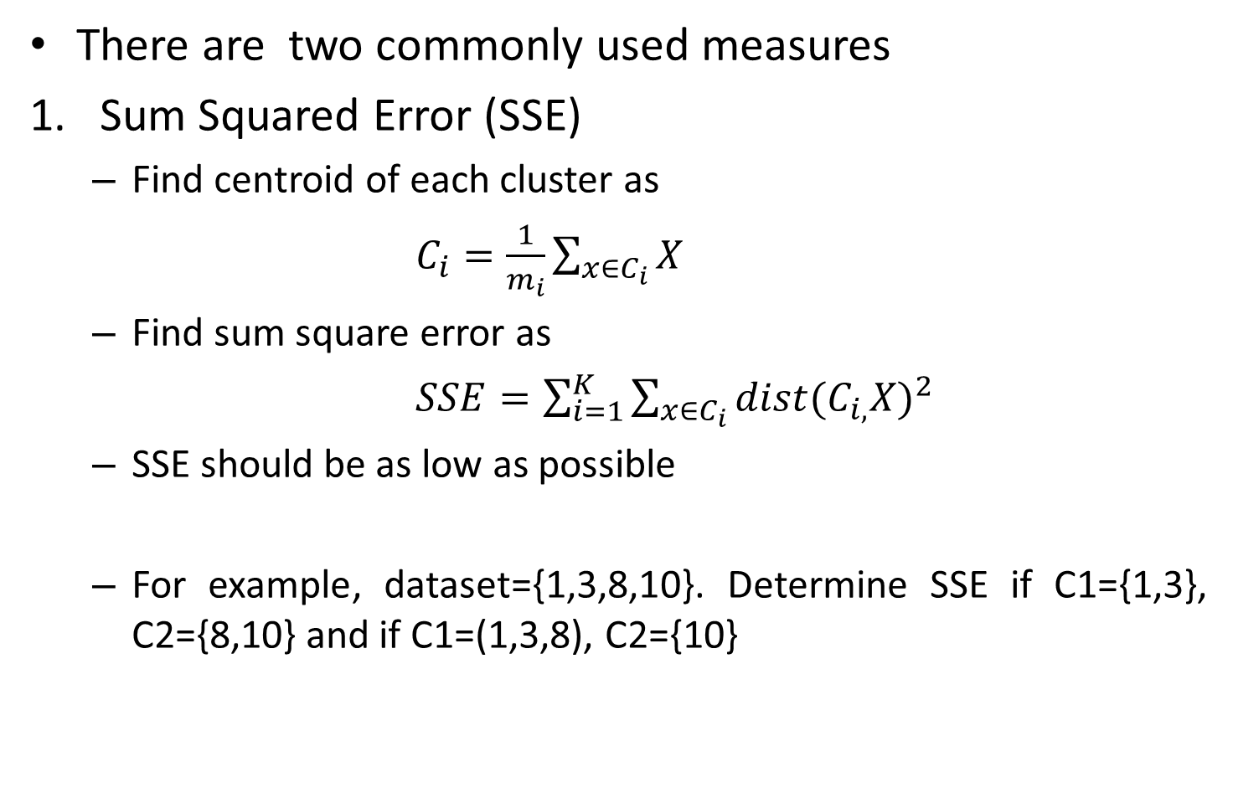
Evaluating clusters
There are two commonly used measures
Sum Squared Error (SSE)
Find centroid of each cluster as
$C_{i}=\frac{1}{m_{i}}\sum_{x∈C_{i}}{X}$
Find sum square error as
$SSE=\sum_{i=1}^{K}{\sum_{x∈C_{i}}{{dist(C_{i,}X)}^{2}}}$
SSE should be as low as possible
For example, dataset={1,3,8,10}. Determine SSE if C1={1,3}, C2={8,10} and if C1=(1,3,8), C2={10}

Slide 12
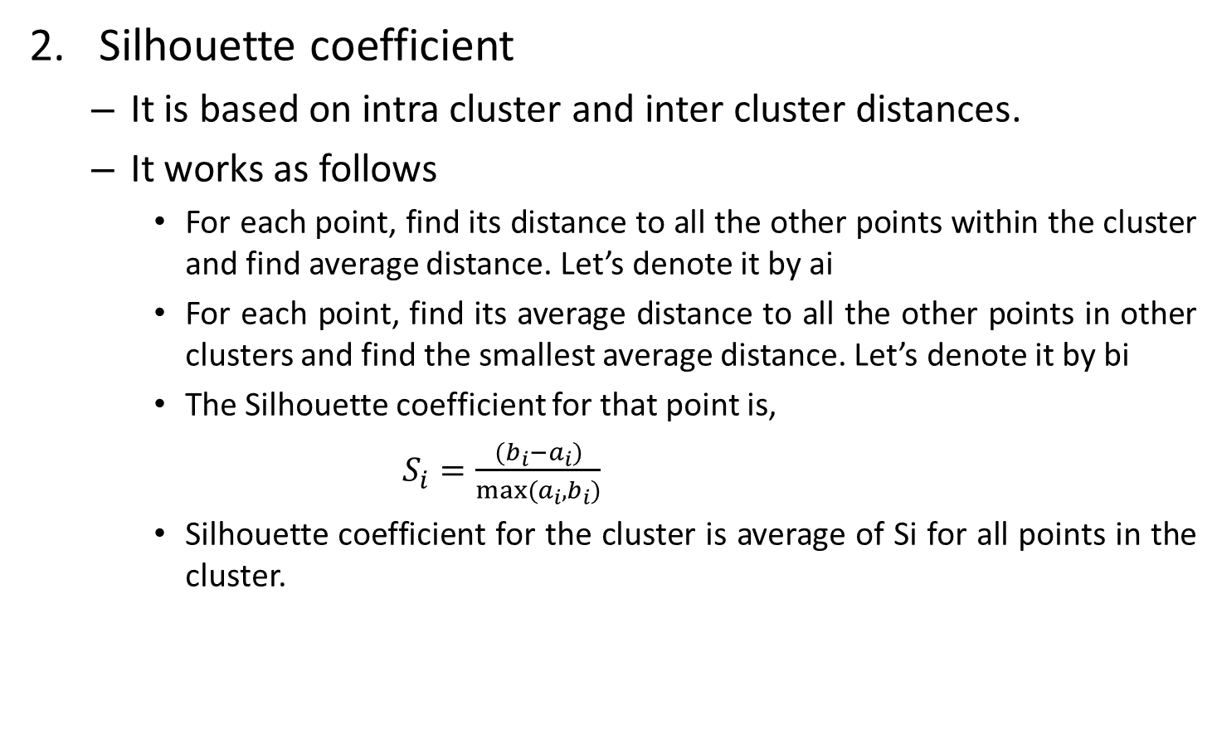
Evaluating clusters
Silhouette coefficient
It is based on intra cluster and inter cluster distances.
It works as follows
For each point, find its distance to all the other points within the cluster and find average distance. Let’s denote it by ai
For each point, find its average distance to all the other points in other clusters and find the smallest average distance. Let’s denote it by bi
The Silhouette coefficient for that point is,
$S_{i}=\frac{(b_{i}−a_{i})}{max⁡(a_{i},b_{i})}$
Silhouette coefficient for the cluster is average of Si for all points in the cluster.

Slide 13
Evaluating clusters
Clusters | Intra-cluster | ai | Inter-cluster | bi | Si | Cluster’s Silhouette Score
1 | 2,4 | 3 | 7,8,9 | 8 | 0.63 | 0.52
3 | 2,2 | 2 | 5,6,7 | 6 | 0.67
5 | 4,2 | 3 | 3,4,5 | 4 | 0.25
8
9
10
Profiling clusters
It is used to describe/summarize the generated clusters.
Allows users to draw insights/conclusions from the clusters.
Common steps are
Count number of objects in each cluster (segment size)
Calculate mean/median/min/max etc for each variable across all the clusters
Convert the description into visual pattern such as heat map for better interpretability.

Slide 14
Principal Component Analysis
Curse of dimensionality
With increase in dimensionality, the amount of data needed to get sound and reliable results from ML models grows exponentially.
Dimensionality reduction
Feature selection: Methods such as attribute relevance analysis can be used to select top relevant features.
Learning from dropped features will be missed out.
Feature extraction: New features are extracted from the existing ones by projecting them on to new feature space.
PCA is used for feature extraction

Slide 15
Principal Component Analysis
It combines the existing variables in such a way that each of the new variables retains varying degree of information from all the existing variables.
Because of this, even if we drop some of these new variables, which could retain very little information from the existing ones, then also final result of the ML model won’t be affected adversely.
There are two more advantages
The new variables are independent of each other
The entire process is completely reversible without any loss of information

Slide 16
Principal Component Analysis
It has following steps
For each column (existing variable), subtract the mean of that column from every value in the column. Call this matrix X.
Take the transpose of X and multiply it with X, ie X^{T}*X. This resultant matrix after multiplication is called Covariance matrix of X
Calculate eigen vectors and corresponding eigen values of the Covariance matrix of X
Arrange the eigen vectors in descending order of eigen values in a new matrix. Call this matrix P.
This matrix P contains our newly extracted variables, where each column of the matrix is an eigen vector.
Each eigen value is an indicator of how much learning information is retained by that new variable.

